Slide 1
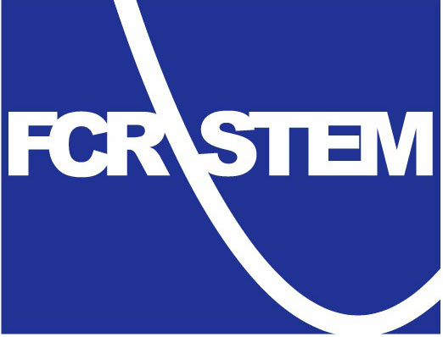
Lesson Study Races to the Top in Florida
A Report on Lesson Study Initiatives In The Sunshine State
Collaborate • Plan • Align • Learn • Motivate • Share

Slide 2
A Brief History of Lesson Study in Florida
2003- Alice Gill delivered a lesson study presentation to the Volusia Co. Teachers Organization (VTO). A team of eight teachers from six elementary schools deliver their first lesson.
2005 - The Office of Science Teaching Activities (OSTA) at Florida State University implements LS in a local elementary school and in the science department of a local high school.

Slide 3
A Brief History of Lesson Study in Florida
2009 – The Florida Department of Education (FDOE) includes Lesson Study as an intervention for failing and low-performing schools in its Differentiated Accountability Plan for the state.
2010 – Lesson Study is featured as an integral component of Florida’s Race to the Top application.

Slide 4
Lesson Study and the RTTT
Teachers will…continuously improve their practice by engaging with other teachers in lesson study and other job-embedded professional development (FDOE, 2010 p.11).
By 2013-2014, all participating LEAs will fully implement lesson study supported by high-quality, web-based resources (p. 94).

Slide 5
Lesson Study and the RTTT
As required by Florida’s MOU, LEAs must:
Modify school schedules to accommodate lesson study” in persistently lowest-achieving schools and may do so in other schools.
Ensure that professional development programs at all schools focus on the new common core standards… Such professional development will employ formative assessment and the principles of lesson study (FDOE, 2010 p. 80).

Slide 6
Lesson Study Will Support:
Formative Assessment Systems for K-8 mathematics, Algebra I, and geometry; and K-8 reading.
Use of Assessment Data for K-12 reading and language arts, K-8 mathematics, Algebra I, geometry, Algebra II, K-8 science, biology, physics, chemistry, earth/space science, K-8 social studies, U.S. history, world history, U.S. government, economics, and Spanish.

Slide 7
Lesson study resources will include:
background study materials to understand types and valid uses of data,
identification of tools available to collect and display data,
lesson study practices that assist teams to connect lesson design and teacher behaviors to student outcomes as evidenced by data(FDOE, 2010 p. 96),

Slide 8
Leading the Charge
The Florida Center for Research in Science, Technology, Engineering, and Mathematics is a multidisciplinary research center created by the Florida Legislature in 2007 with a mission to help the State of Florida improve teaching and learning in K-12 STEM and prepare students for higher education and STEM careers in the 21st century.
Located at The Florida State University, FCR-STEM is jointly administered by the College of Arts & Sciences, the College of Education and the Learning Systems Institute (LSI).

Slide 9
FCR-STEM Initiatives
Helios (STEM integration) ($495,000)
8 math & science LS teams in 4 Citrus County middle schools
Funding for six LS cycles per team
BIOSCOPES (Math/Science Partnership) ($5.4 million)
LS cycles for over 40 teams (200 teachers) throughout Fl in 2011-12; over 110 teams (580 teachers) for fall 2012 spring 2013
Hosting LS facilitator workshop May 17, 2012

Slide 10
FCR-STEM Initiatives
CPALMS ($10.5 million)
High-quality, standards-based, expandable, on-line platform for integrating standards, courses, lesson resources, formative assessments, on-line PD, lesson study resources, etc.
Mathematics Formative Assessment System (MFAS) ($2.8 million)
18 LS toolkits for K-3 mathematics by summer 2012 ($900,000)
All toolkits focus on formative assessment

Slide 11
Helios: Integrating STEM, Math, Science, and Computing
Partnership between the Helios Education Foundation, Florida State University, Citrus Co. Public Schools, and the Southwest Water Management System.
Two over-arching goals:
Improve the quality of integrated math and science instruction in middle schools
Establish Lesson Study as a systemic model for middle grades mathematics and science teacher professional development in Citrus County.

Slide 12
Helios: Integrating STEM, Math, Science, and Computing
Over two years the Integrating STEM project will provide 120 hours of content-focused PD for middle grade science and math teachers in Citrus County through:
Summer PD workshops (4 days per summer)
4 PD days during each academic school year
Establishment and Support of 8 LS teams for 3 LS cycles per academic year
STEM Summer Bridge Program: 15 teachers will co-teach lessons and engage in LS in the delivery of a 5-day STEM enrichment program for academically at-risk rising 6th graders.

Slide 13
BIOSCOPES
The Biology Institute and Online Support: Collaborative Opportunities to Promote Excellence in Science (BIOSCOPES) is:
a Next Generation Science Partnership of FCR-STEM at FSU; the Panhandle Area Educational Consortium (PAEC), and 20 urban, mid-sized and rural districts in North and Central Florida.

Slide 14
BIOSCOPE’S MAIN GOALS
1. Enhance pedagogical content knowledge of science teachers of middle school students and high school Biology I students.
2. Develop sustainable Lesson Study teams to provide ongoing support for increasing the quality and rigor of science instruction aligned with the NGSSS.

Slide 15
BIOSCOPE’S MAIN GOALS
3. Enhance participating teachers’ implementation of high-quality science instruction for middle school students and high school Biology I students.
4. Enhance student achievement in science in middle and high schools.

Slide 16
Lesson Study Toolkit Project
The Lesson Study Toolkit Project (LSTP) will engage LS teams of K-12 teachers in the development of toolkits that will be used by lesson study groups as frameworks for researching and designing instructional units to address key topics in the CCSS and NGSSS.
12 subject-specific toolkits will be developed for CPALMS, for a minimum of one each per grade level (K-2, 3-5, 6-8, 9-12), in each of the three subject areas of mathematics, science, and English language arts.
Collaborate • Plan • Align • Learn • Motivate • Share

Slide 17
Lesson Study Support System (LSSS)
The LSSS will guide LS teams through:
Establishing a team (recruiting, scheduling, group norms)
Setting team goals (research theme)
Conducting background research (student data, research on teaching & learning, formative assessments)

Slide 18
Lesson Study Support System (LSSS)
Planning a research lesson based upon the team’s research
Teaching a research lesson
Debriefing, Re-teaching, and reflecting on the lesson & process
Reporting and sharing the team’s work

Slide 19
Lesson Study Support System
Collaborate • Plan • Align • Learn • Motivate • Share
CPALMS•org
Notes:
Through the LSSS the Lesson Study Team is able to: Export a the toolkit out of their work in different formats; Connect to the CPALMS Lesson Planning Tool to build a Lesson; Connect to the Formative Assessment Task Builder to build a formative assessment task; Select lessons, formative assessment tasks, and other resources already on CPALMS; Select existing toolkits to start from; and much more.

Slide 20
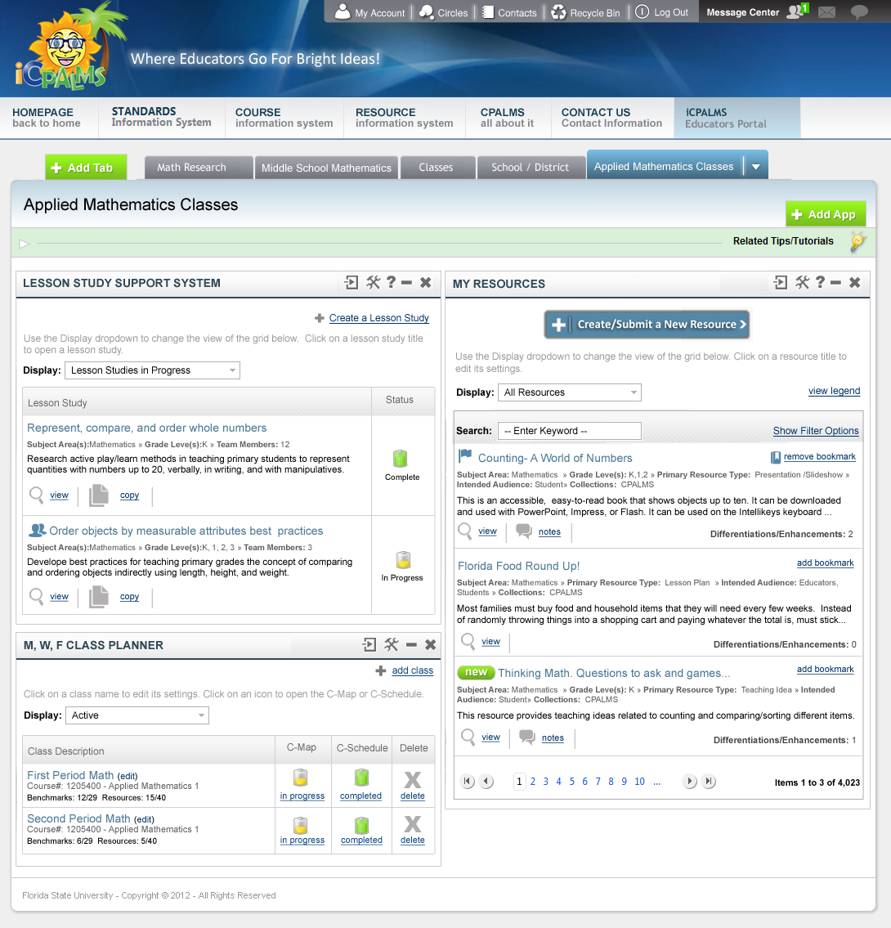
Notes:
This screen shows how the LSSS App within iCPALMS will appear. A user can initiate a lesson study cycle, form a team, track progress, and archive complete cycles. In future versions, the user will be able to see notifications of new things related to them (e.g., a notification that your team member added/modified an item in the cycle).

Slide 21
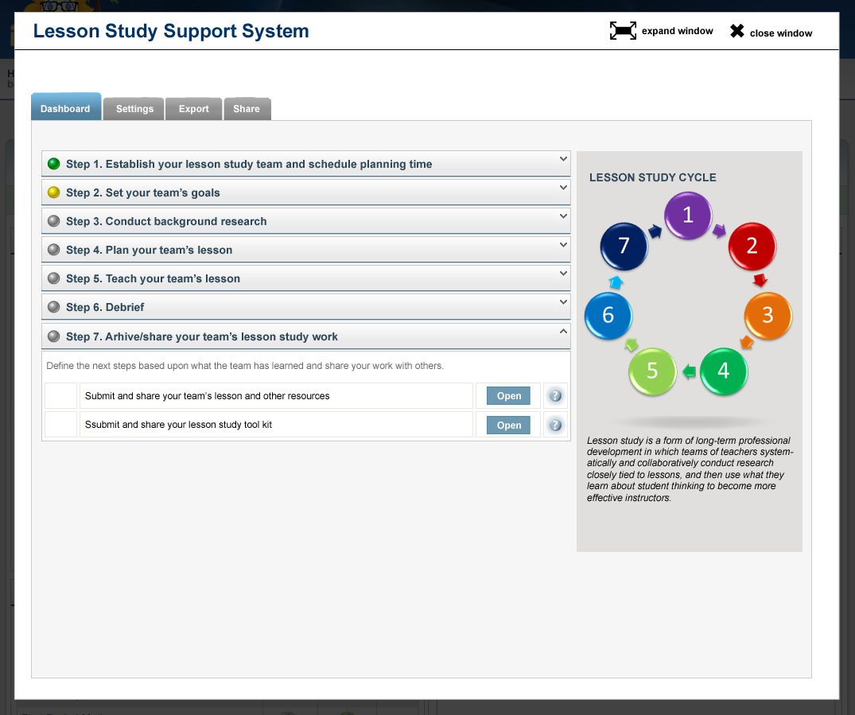
Notes:
By going through the LSSS, the Lesson Study team will be creating a toolkit. In other words, the product of going through this system is a toolkit. After the Lesson Study Team goes through a cycle of Lesson Study, they can choose to share the resulting lesson, formative assessment task, and other resources with other users in CPALMS. They can share these resources as part of the toolkit and/or individually as independent resources.

Slide 22
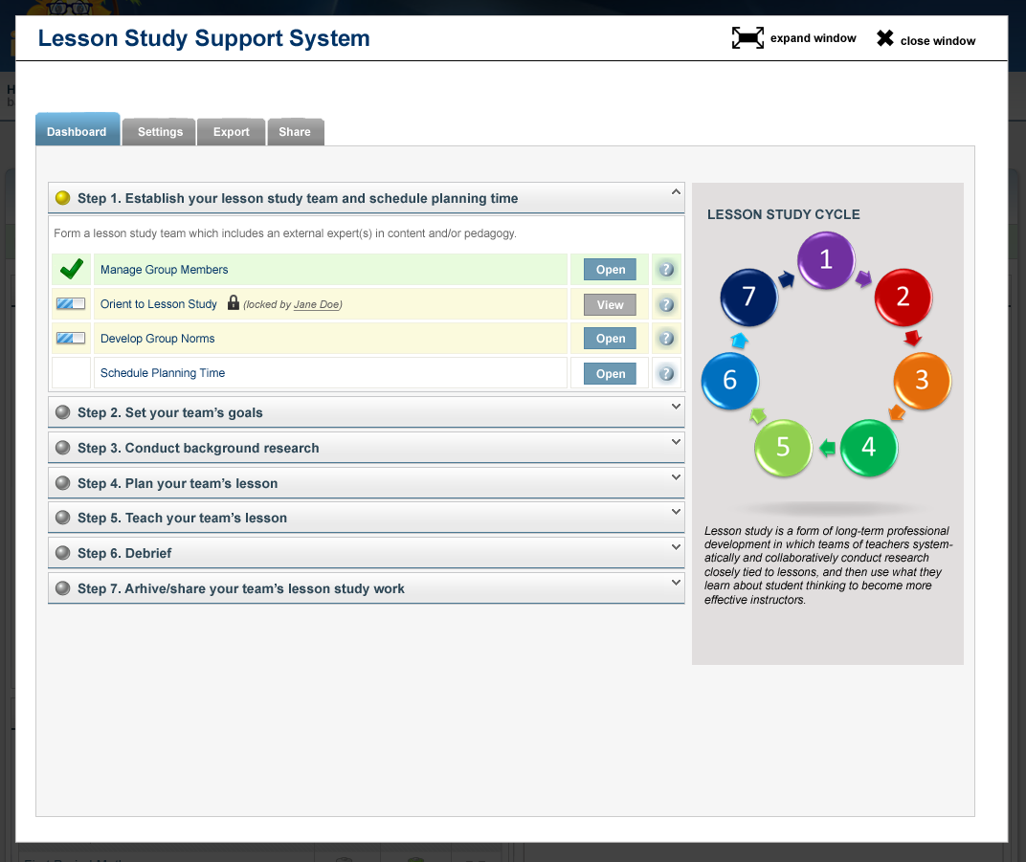
Notes:
Once the user opens a particular lesson study cycle on the previous screen, they will get to a dashboard that shows them the overall process, steps and their progress in each of them. This is a system that allows the lesson study team (also can include knowledgeable other) to learn about and communicate through the lesson study cycle. Team members can roll over the help icons to get descriptions of the steps or sub steps. Users are also able to visually determine if a step or sub step is complete. The system will protect users from editing the same section at the same time to avoid overwriting each other’s work. Clicking on a sub step will take the user to another screen specific for that section.

Slide 23
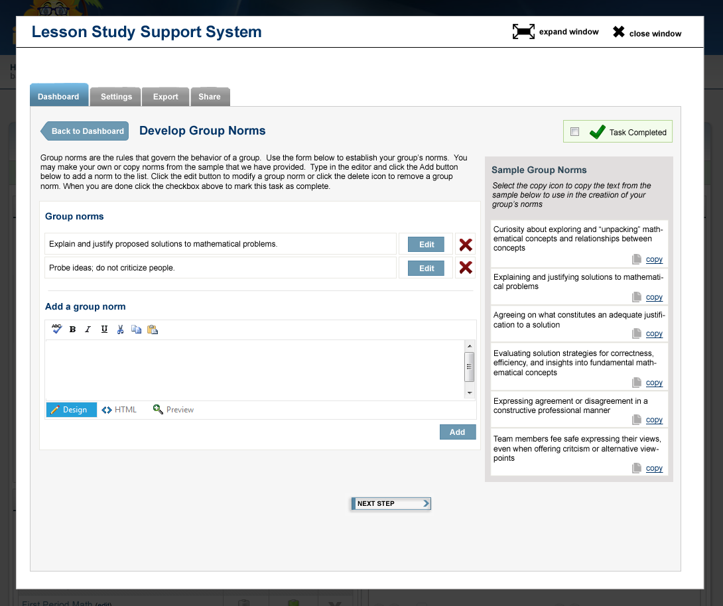
Notes:
This screen shows the group norms section. Users can see sample group norms that they can choose from. These sample norms are provided in the application and managed by the LSSS administrators. The Lesson Study team can create custom norms as well.

Slide 24
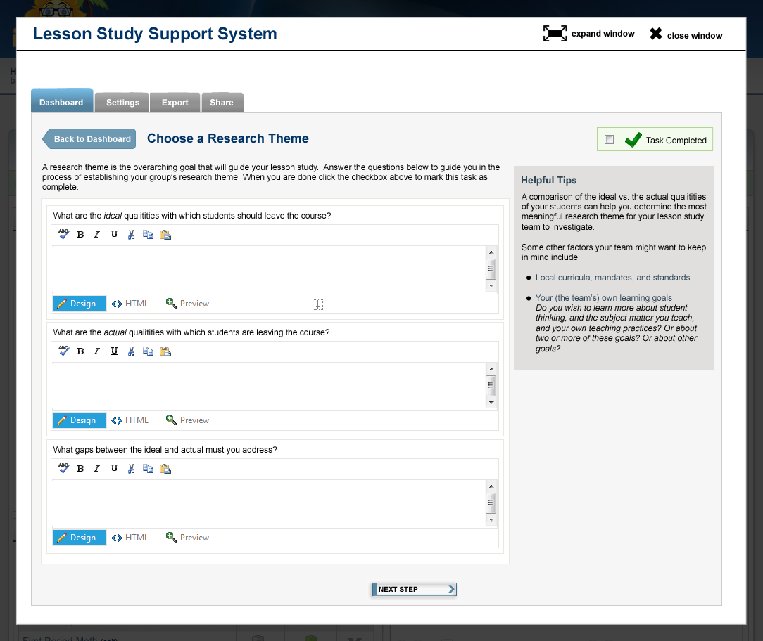
Notes:
This screen shows the sub step where the Lesson Study Team can define their research theme.

Slide 25
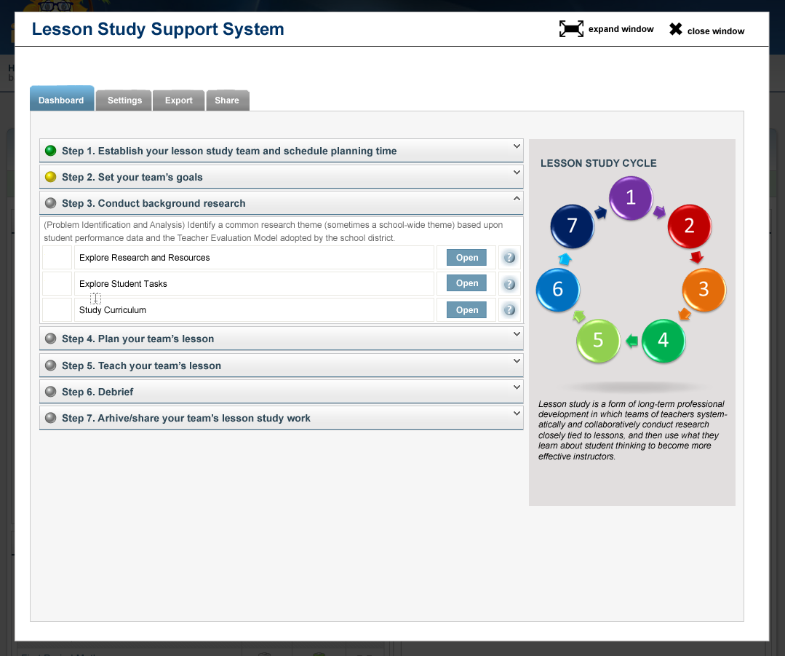
Notes:
This screen shows Step 3 and the sub steps within it.

Slide 26
